Slide 1
Flow System, Activity Relations and Space Requirement
Presented By
Syed Adil Mustafa 11-IE-62
Maaz Elahi 11-IE-31
Sameer Safdar Khan 11-IE-27

Slide 2
Flow Systems
Flow can be defined as
Movement of goods, materials, energy, information and/or people
Types of Flow
Continuous Flow
Discrete Flow

Slide 3
Flow Process
Flow Process
The Subject of Flow
Communication
The Recourse

Slide 4
Types of Flow System
Flow System
Material Management System
Material Flow System
Physical Distribution System

Slide 5
Material Flow System
Flow of materials, parts and supplies within manufacturing system
It includes
Production and Quality Control Departments
Manufacturing , assembly and storage departments
Material handling Equipment
The warehouse

Slide 6
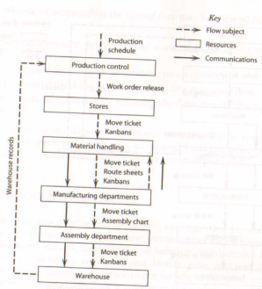
Material Flow System

Slide 7
Material Flow System
Material Flow System can be done by
Simplification approach
Minimization of cost
Simplification Approach
Eliminating Flow by Planning
Minimizing Multiple Flows
Combining Flows and operations

Slide 8
Material Flow System
Minimization of cost
Reducing Flow Density
Minimize travelling distance
Automating Flow
Eliminating unnecessary steps

Slide 9
Material Flow System
We will consider three flows
1.Flows within Workstations
2.Flows within Departments
a. Flow within product Departments
b. Flow within process Departments
c. Flow within product and process Departments with material handling consideration
3.Flows Between departments

Slide 10
Flow within Workstation
Flow in workstation should be
Simultaneous
Symmetrical
Natural
Rhythmical
Habitual

Slide 11
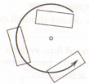
Flow within Department Flow within Product Department
Flow is sequential or with no backtracking
The flow of work follows the product flow with following patterns
End-to-End Back-to-Back Front-to-Front
Circular Odd-angle

Slide 12
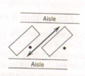
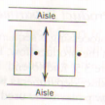
Flow within Process Department
Similar or identical machines are in same department
Minimum amount of flow occurs and it is between workstations and aisles
Diagonal Perpendicular
Parallel

Slide 13
Flow within product and process Departments with material handling consideration
It consists of following pattern
The line flow pattern
The spinal flow pattern
The loop flow pattern
The tree flow pattern

Slide 14
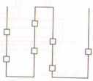
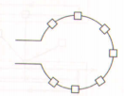
The Line Flow Pattern
It has following types
I-flow W-flow U-flow
S-flow O-flow

Slide 15
The Spinal Flow Pattern
It has material handling devises along central spine
Stations are connected to main flow through spurs
It is used for both flow within the department and between department
Spinal flow

Slide 16
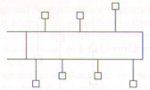
The Loop Flow Pattern
It has loop around workstation
Flow direction may be unidirectional or bidirectional
Inner-loop Outer-loop

Slide 17
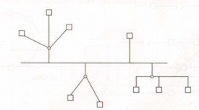
The Tree Flow Pattern
Workstations are positioned in the tree

Slide 18
Flow Between Department
In this flow separate delivery and pickup station for each department and these are fixed
Depending on the condition, one station may be served for both receiving and delivering purpose or separate stations may be used
Depending upon the station sides, following are classification
At the same location On the Adjacent Sides
On the same Side On the Opposite Sides

Slide 19
Flow Planning Hierarchy
Effective Flow b/w Depts
Effective Flow within Depts
Effective Flow within Workstations

Slide 20
Path Flow
Directed Flow Path
A directed flow path is an uninterrupted flow path progressing directly from origination to destination.
Uninterrupted Flow Path
Uninterrupted flow path is the flow path that does not intersect with other paths
Uninterrupted Flow Path

Slide 21
Path Flow
Interrupted Flow Path
Interrupted flow path is the flow path that intersects with other flow paths, increasing congestion and undesirable intersections.
Interrupted flow path causes trouble in smooth flow and backtracking penalty is mostly encountered.

Slide 22
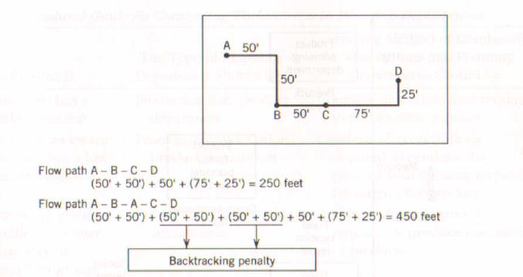
Backtracking Penalty
Backtracking Penalty = 200 feet

Slide 23
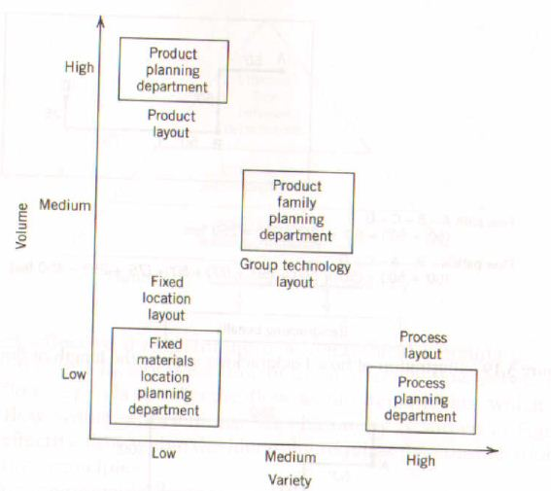
Departmental Planning
The problem of forming planning departments. Planning department involve production, support, administrative, and service areas.

Slide 24
Combining Workstation in Departmental Planning
If The Product Is | The Type of Planning Should be | The Method of Combining Workstations into Planning Department
Standardized and large stable Demand | Production Line Product Department | Combine all workstation required to produce the product
Physically Large Awkward to move and has small sporadic demand | Fixed material location product department | Combine all workstation required to produce the product and area for the product
Capable of being grouped into families of similar parts that maybe produced by a group of workstations | Product family product department | Combine all workstation required to produce the family of products
None of above | Process Department | Combine identical and similar workstations

Slide 25
Product Family Departments
Product family or group technology departments aggregate medium volume-variety parts into families based on similar manufacturing operation or design attributes. Machines required to manufacture the part family are grouped together to form a “cell” thus the label cellular manufacturing. Manufacturing cell can be formed in many ways, with most popular involving the grouping of:
Machines
Employees
Materials
Tooling
Material handling
Storage equipment

Slide 26
Direct Clustering Algorithm(DCA)
Steps
Step 1: order the rows and columns. Sum the 1s in each column and each row of machine-part matrix. Order the rows top to bottom in descending order of no. of 1s and order the columns left to right in ascending order of no. of 1s in each. Where the ties exist break the ties in numeral sequence.
Step 2: Sort the columns. Beginning with first row of the matrix shift to the left of the matrix all columns having 1 in the first row. Continue the process row by row until no further opportunity exists for shifting columns.

Slide 27
Direct Clustering Algorithm(DCA)
Step 3: Sort the rows. Column by column, beginning with the leftmost column, shift rows upward when opportunities exist to form block of 1s.
Step 4: Form cells. Look for opportunities to form cells such that all the processing for each part occurs in a single cell.

Slide 28
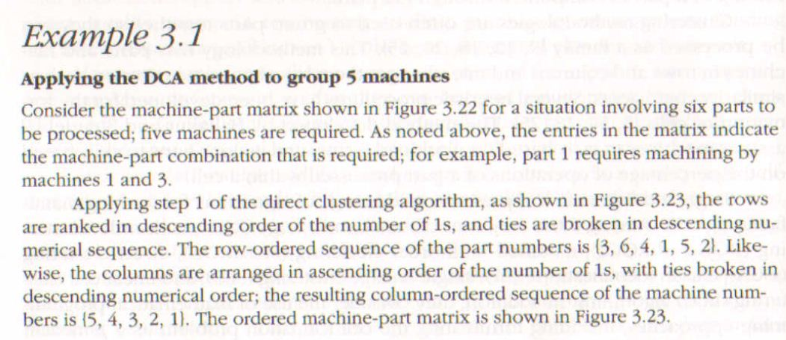
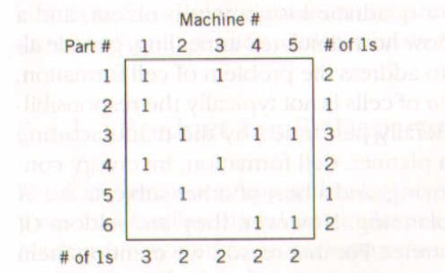

Slide 29
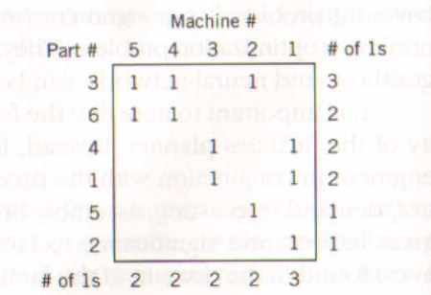
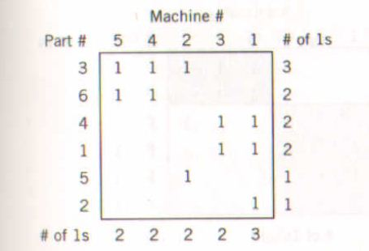
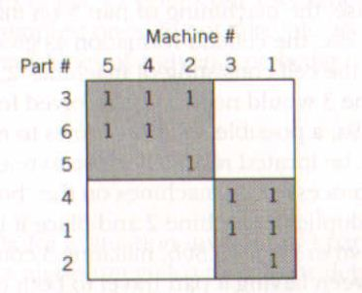
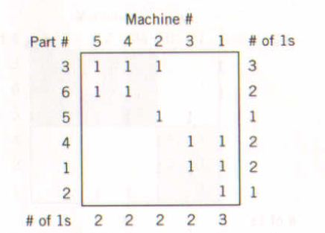

Slide 30
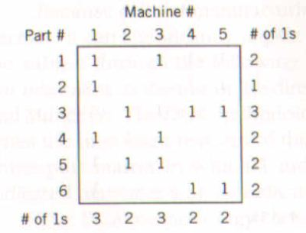
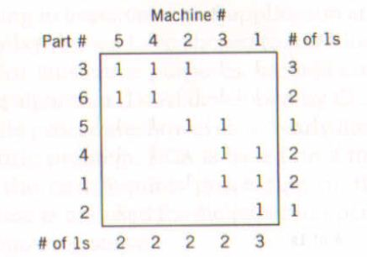
Example 3.2
Using DCA method to determine alternative groupings of machines

Slide 31
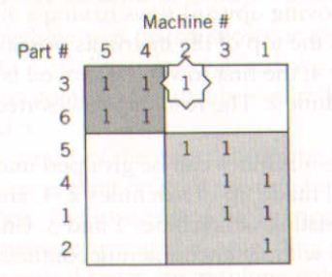
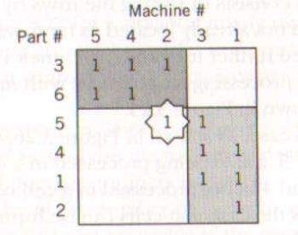
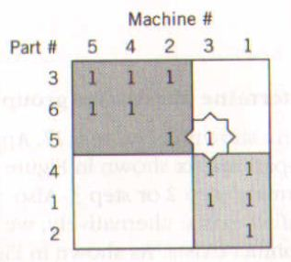
Example 3.2

Slide 32
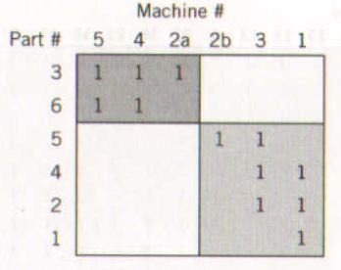
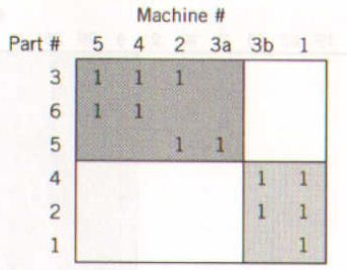
Example 3.2

Slide 33
Cellular Manufacturing and Kanban
A decoupled cellular manufacturing system uses storage area to store part families completed in the cell.
Whenever another cell is to operate on the parts
They retrieved from the storage area
The storage area acts as a decoupler.
This approach lead to excessive material handling and poor response time.
To eliminate inefficiencies integrated approach is used.
Here cells are liked together through KANBANs.

Slide 34
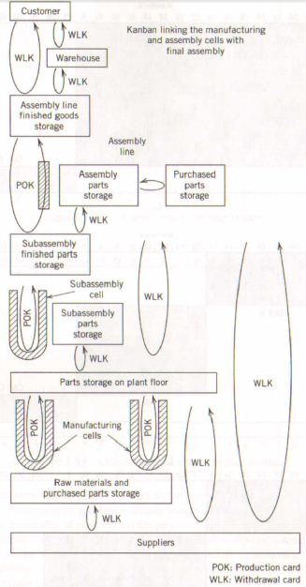
Cellular Manufacturing and Kanban
Production Cards (POK)
Are used to authorize the production of more components, subassemblies, parts and raw materials.
Withdrawal Cards (WLK)
Are used to authorize delivery more components, subassemblies, parts and raw materials.
Pull System preferred over Push System

Slide 35
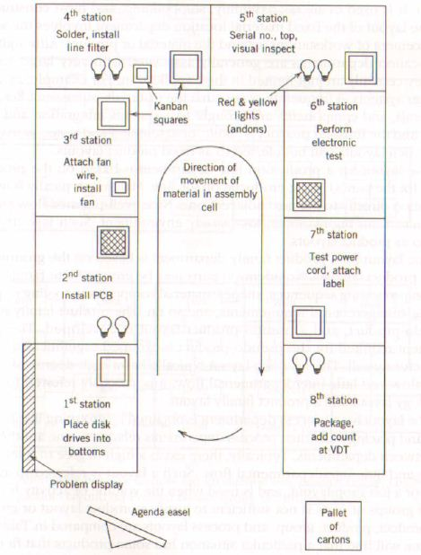
Assembly Cell Layout ofHewlett-Packard Greely Division
Agenda Easel
Info about daily production requirements of cell
Andons
Are red and yellow lights are used to stop production whenever there is a problem

Slide 36
Layout Based On Material Flow System
There are four types of production planning department
Production Planning Department
Production Line Department
Fixed Material Location Department
Product Family Department
Process Department

Slide 37
Production Line Department
Its layout depends on Production sequence
Material flows from one station to adjacent station
It generates high-volume, low-variety products
Production Line Department Layout

Slide 38
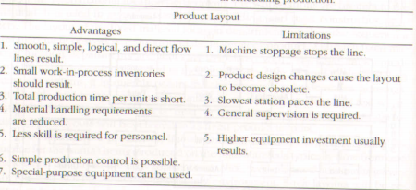
Production Line Department

Slide 39
Fixed Material Location Department
Materials are brought to workstations in other layout but workstation is brought to material in this case
Assembly of aircraft and shipbuilding are its examples.

Slide 40
Fixed Material Location Department

Slide 41
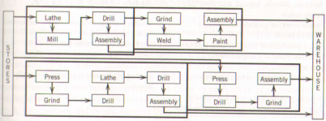
Product Family Department
It is also referred as group technology layout
Non-identical parts are grouped based on shapes, sequence, material composition, tooling requirement, handling/storage requirement
This layout has high degree of intradepartmental flow

Slide 42
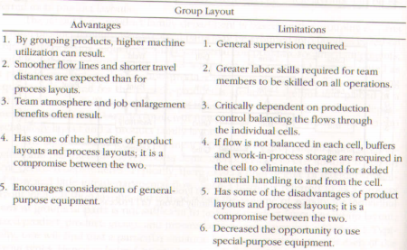
Product Family Department

Slide 43
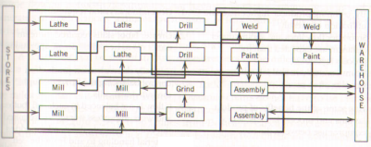
Process Department
Also referred as job shop layout
High degree of interdepartmental flow
It is used when product family layout is not suitable

Slide 44
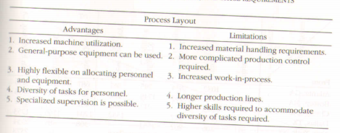
Process Department

Slide 45
Activity Relationship
Activities among department should be measured
Activity relationship should be established which is quantitative or qualitative measure
Quantitative measures include pieces per hour, moves per day etc.
Qualitative measure represents flow of information

Slide 46
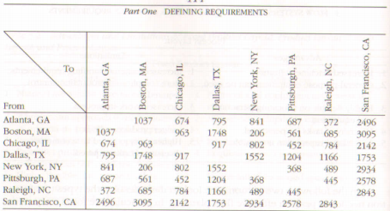
Activity Relationship

Slide 47
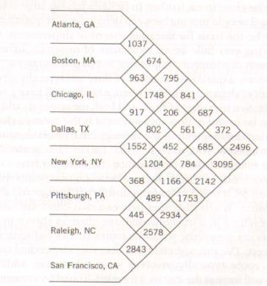
Quantitative Flow Measurement
Flows may be measured quantitatively in terms of amount moved between departments

Slide 48
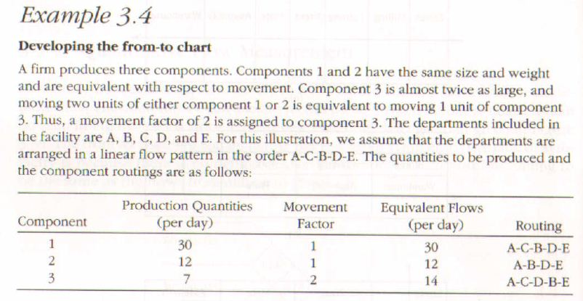

Slide 49
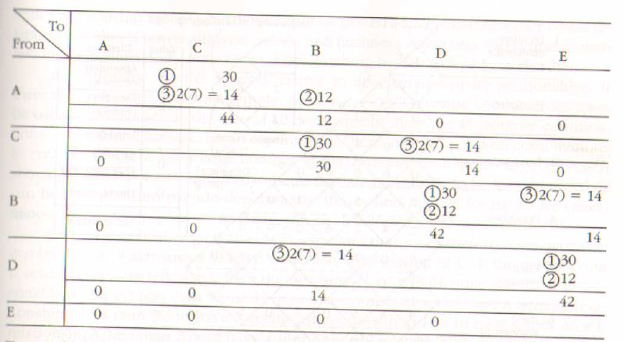

Slide 50
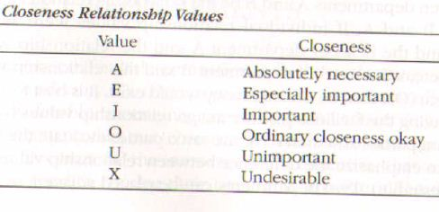
Qualitative Flow Measurement
Flows may be measured qualitatively using the closeness relationship values.

Slide 51
Relationship Chart

Slide 52
Space Requirements
Planning of amount of space required in the facility.
The design year for a facility is typically 5 to 10 years in the future.
Parkison’s Law:
Things will expand to fill all available capacity sooner than you plan. Hence, even though the facility might be constructed with sufficient space for the future, when the future arrives, there will be no space available for it.

Slide 53
Space Requirements
For Warehousing Activities:
Inventory levels, storage units, storage methods and strategies, equipment requirements, building constraints, and personnel requirements must be considered.
Manufacturing and Office Environment:
Individual workstation, equipment, machine travel, machine maintenance and plant services

Slide 54
Thank You !!!
ANY QUESTIONS

